Slide 1
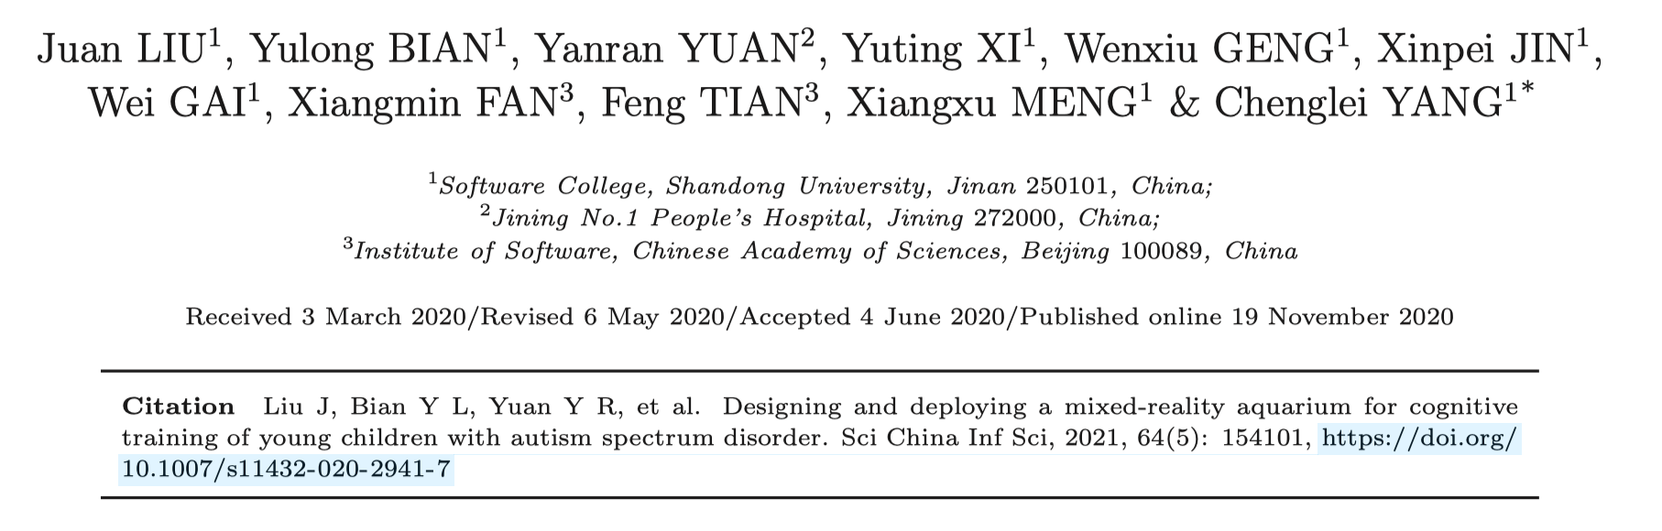
MOOP
Designing and deploying a mixed-reality aquarium for cognitive training of young children with autism spectrum disorder

Slide 2
Introduction
Autism spectrum disorder (ASD), a developmental disorder severely aﬀecting cognition and social behavior, is increasing in prevalence. This increasing trend is especially severe in children, making the early intervention crucial to ASD treatment.
Cognition of children with ASD is characterized by impairments in communication skills and reciprocal social interaction and restricted, repetitive, and stereotyped patterns of behavior and interests.
Children with ASD were found to have attention deﬁcit symptoms such as rapid shifting of attention, delay in shifting attention between visual and auditory stimuli, and impaired attention to the most salient or meaningful feature of a stimulus.
Currently, most clinical interventions are conducted by therapists through oral, behavioral, or picture based guidance. Studies have pointed out that these kinds of interventions are not intuitive or vivid enough to appropriately attract attention, stimulate the interest, or bring positive cognitive outcomes of children with ASD.（Some of these interventions may even cause a high cognitive load to the ASD children that leads to the loss of attention.）

Slide 3
Introduction
To address this, interventions using computer-assisted technology (CAT) are being increasingly considered.
Some studies show that virtual reality (VR) creates a more intuitive, vivid, and immersive interactive environment, which can be potentially used in rehabilitation training for ASD children. Other studies indicate that the VR environment can help maintain ASD children’s interest and enthusiasm during training, as well as improving their motivation, concentration, and performance.
mixed reality(MR) technology
both the real environment and virtual information
do not require on-body equipment were more suitable for ASD children as many of them show a strong aversion to wearing anything on their bodies
MR aquarium
the physical part：a real aquarium with live ﬁsh and water plants
the virtual part：a projection display attached at the back of the aquarium, showing the content of the ASD training course.
an infrared touch screen：enable ASD children to interact with the virtual creatures via Multi-Touch method

Slide 4
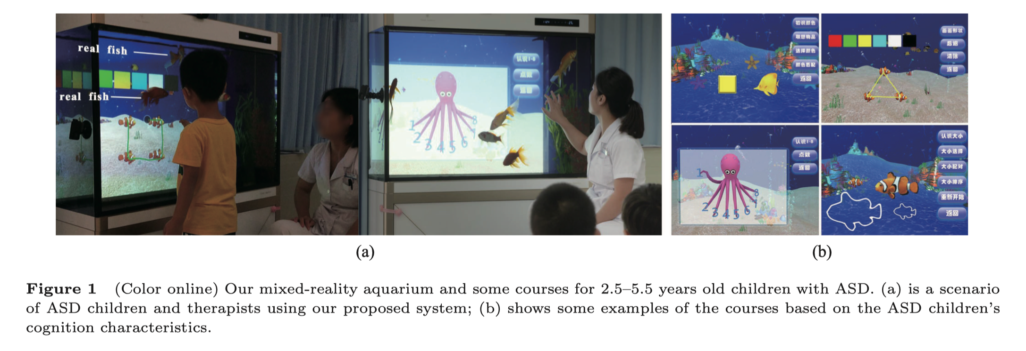
Introduction
Our system allows ASD children to：
(1) take professional cognitive training based on their cognitive characteristics
(2) experience the fantasy training courses in an aquarium environment, which combines a real aquarium with a virtual underwater world, and also provides simple interaction by Multi-Touch technology.

Slide 5
Design of mixed-reality aquarium
This system needs to take animal-assisted interventions into consideration and provide professional training courses which are suitable for the cognitive characteristics of young ASD children.
Animals are very eﬀective elements in promoting the cognitive training of ASD children.
Aquarium ﬁsh has positive eﬀects on people’s physical and mental health.
In the presence of a dog, children with ASD show greater interest and concentration.
Based on ASD children’s cognition characteristics, we work closely with ASD therapists and perform an iterative development to improve the system and course content.
Considering that ASD children are generally problematic in their concentration, we choose bright colors when making virtual underwater scenes to better catch their attention.

Slide 6
Result
two questions：
(1) Understanding the advantages and eﬀects of our MR system on the performance of ASD children during the training.
(2) Understanding the eﬀects of our MR system and course on ASD children’s cognitive ability, as well as their linguistic and motor ability.
20 ASD children (18 males and 2 females) ，age：45.15 (±9.19) months
In this study, the training lasted for one month (four weeks).
Autism Behavior Checklist
the Chinese version of the psycho-educational proﬁle（CPEP3）
a post-training questionnaire
The empirical study involved a design of comparative group having both a pre-test and post-test.
The original participants were randomly and equally assigned to the two groups.
The experimental group participated in an MR course, while the control group did not participate.
The two groups participated in some routine training in the hospital.
The major dependent variable was the improvement of cognitive ability.
The improvements of linguistic and motor ability were also considered as dependent variables.

Slide 7
Result
After one month of MR course training, the cognitive, language and motor ability of ASD children has been signiﬁcantly improved.
Moreover, they show that the MR aquarium and its courses indeed have signiﬁcant potential in the interest development, concentration cultivation and other performance improvement of young ASD children in training.
The mechanism of these positive eﬀects and clinical application of this system remain to be explored, and how to balance the impact of the real and virtual world on children is also worth studying in the future.

